Slide 1
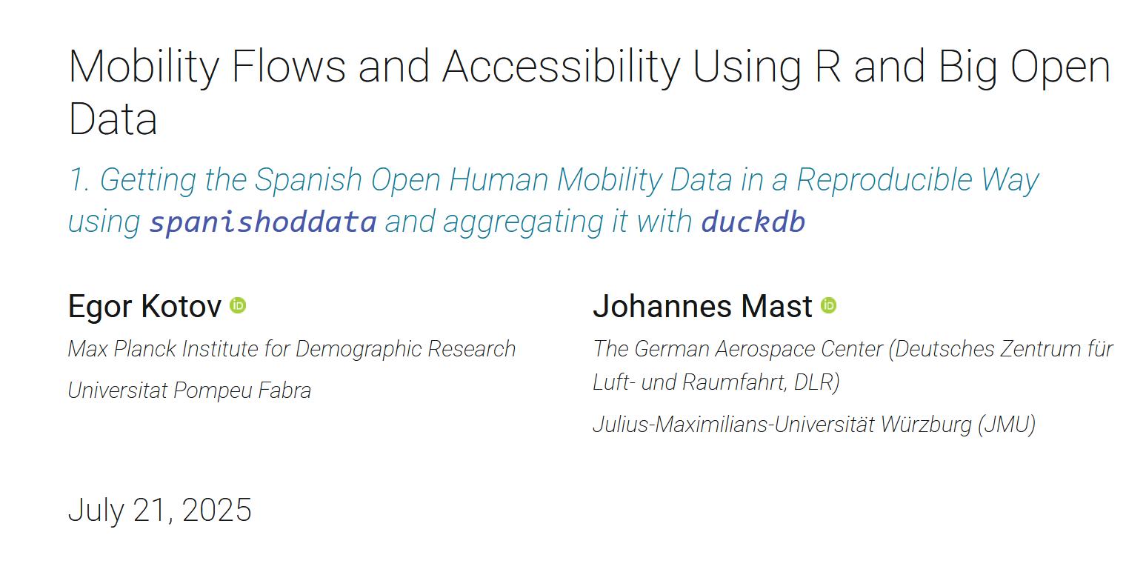

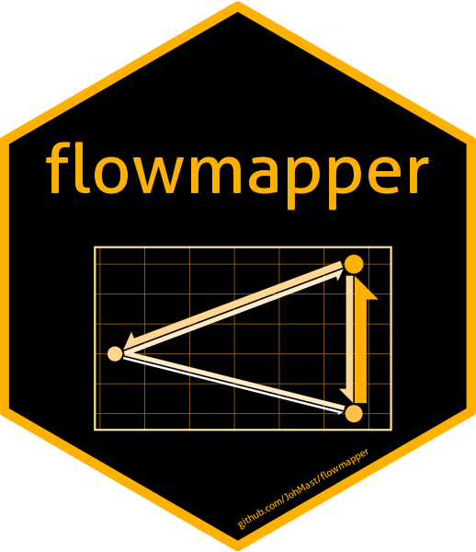
2. Visualization of Mobility using flowmapper and flowmapblue

Slide 2
Agenda
Interactive Visualisations using R::flowmapblue
Static Visualisations using R::flowmapper

Slide 3
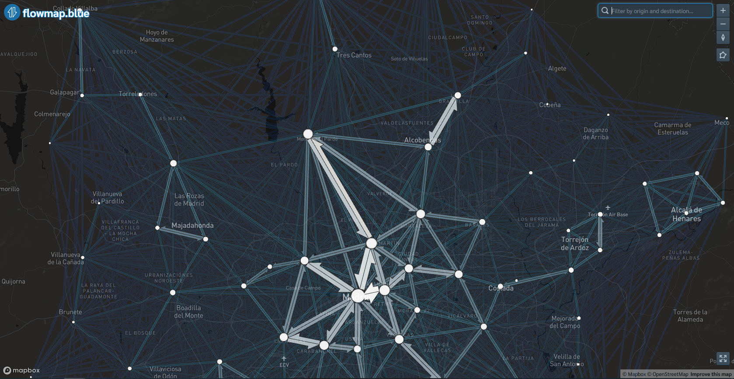
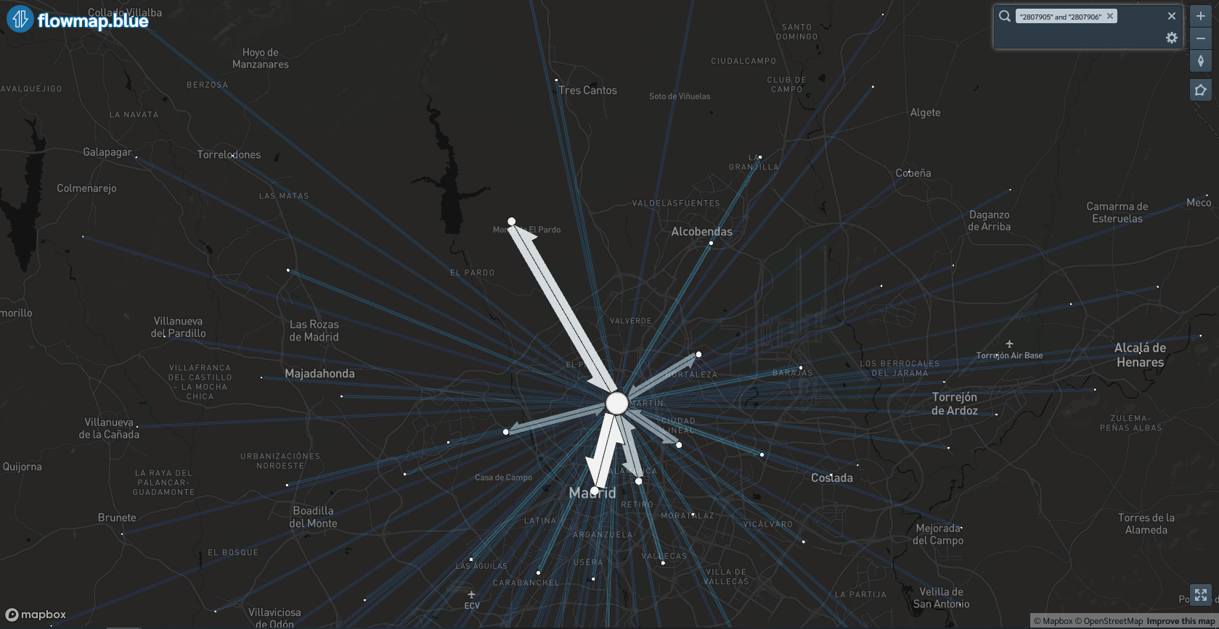
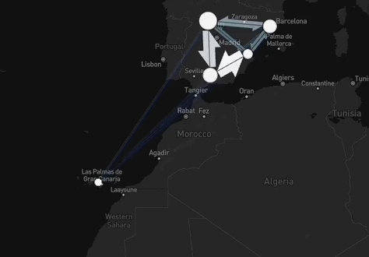
flowmapblue
Available as a web version and as an R package
Interactive visualisations
Part of the flowmap suite, continously developed

Slide 4
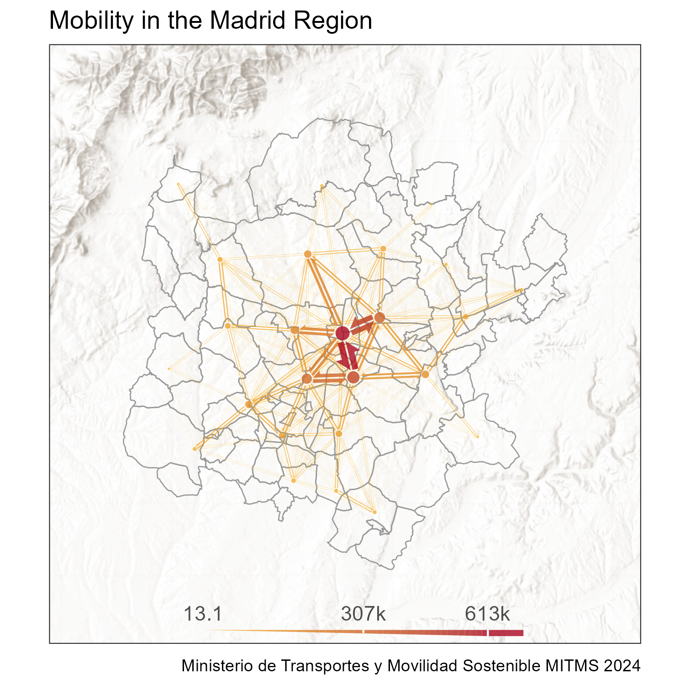
flowmapper
Inspired by flowmapblue
Static visualisations within the R::ggplot2 framework
Capacity to export as spatial objects

Slide 5
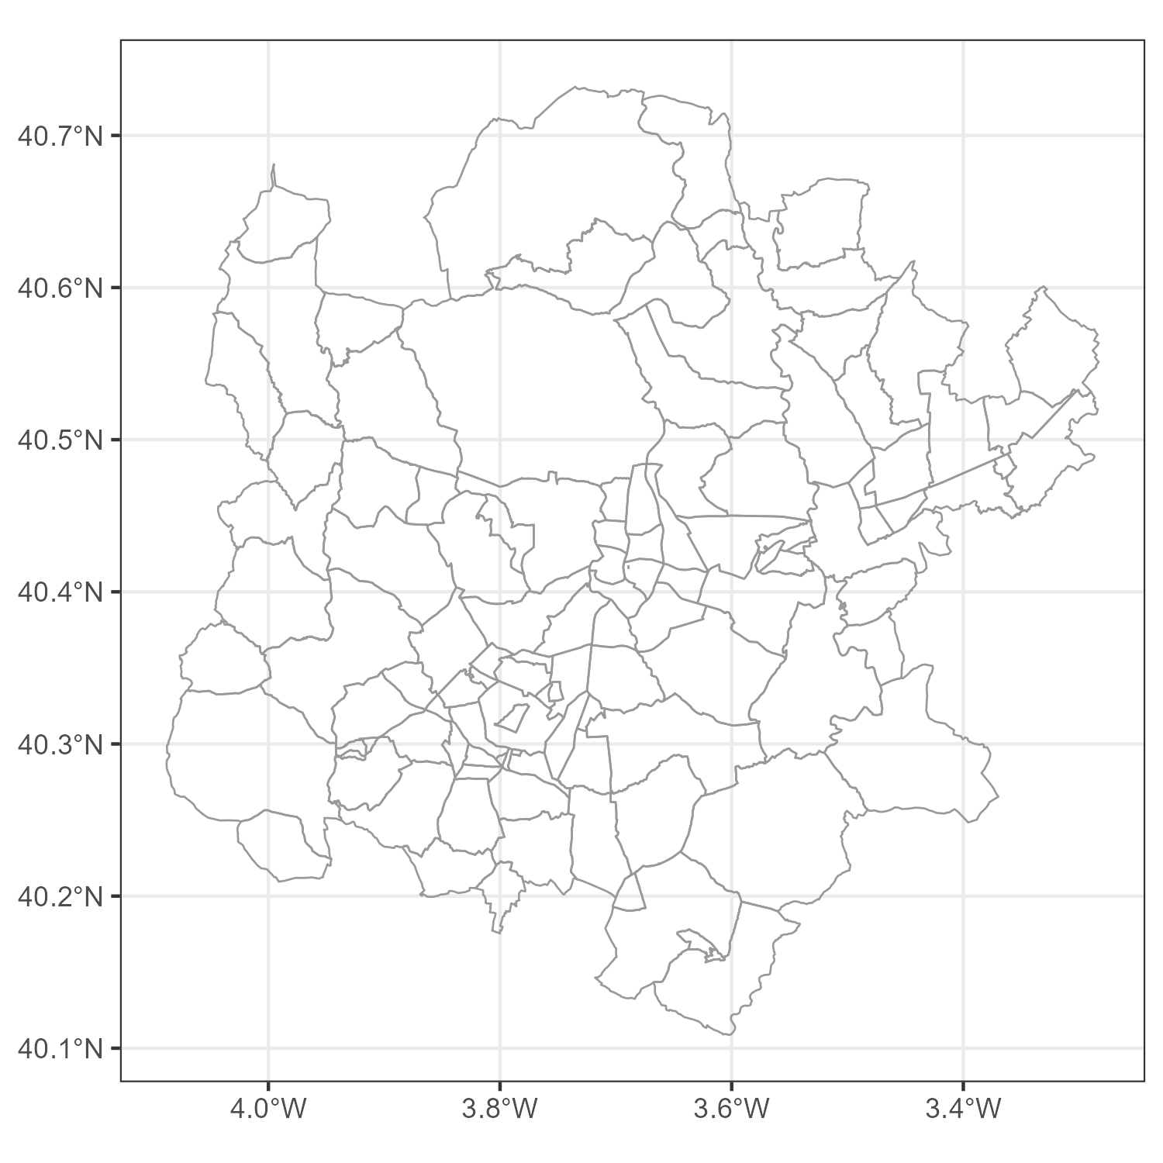
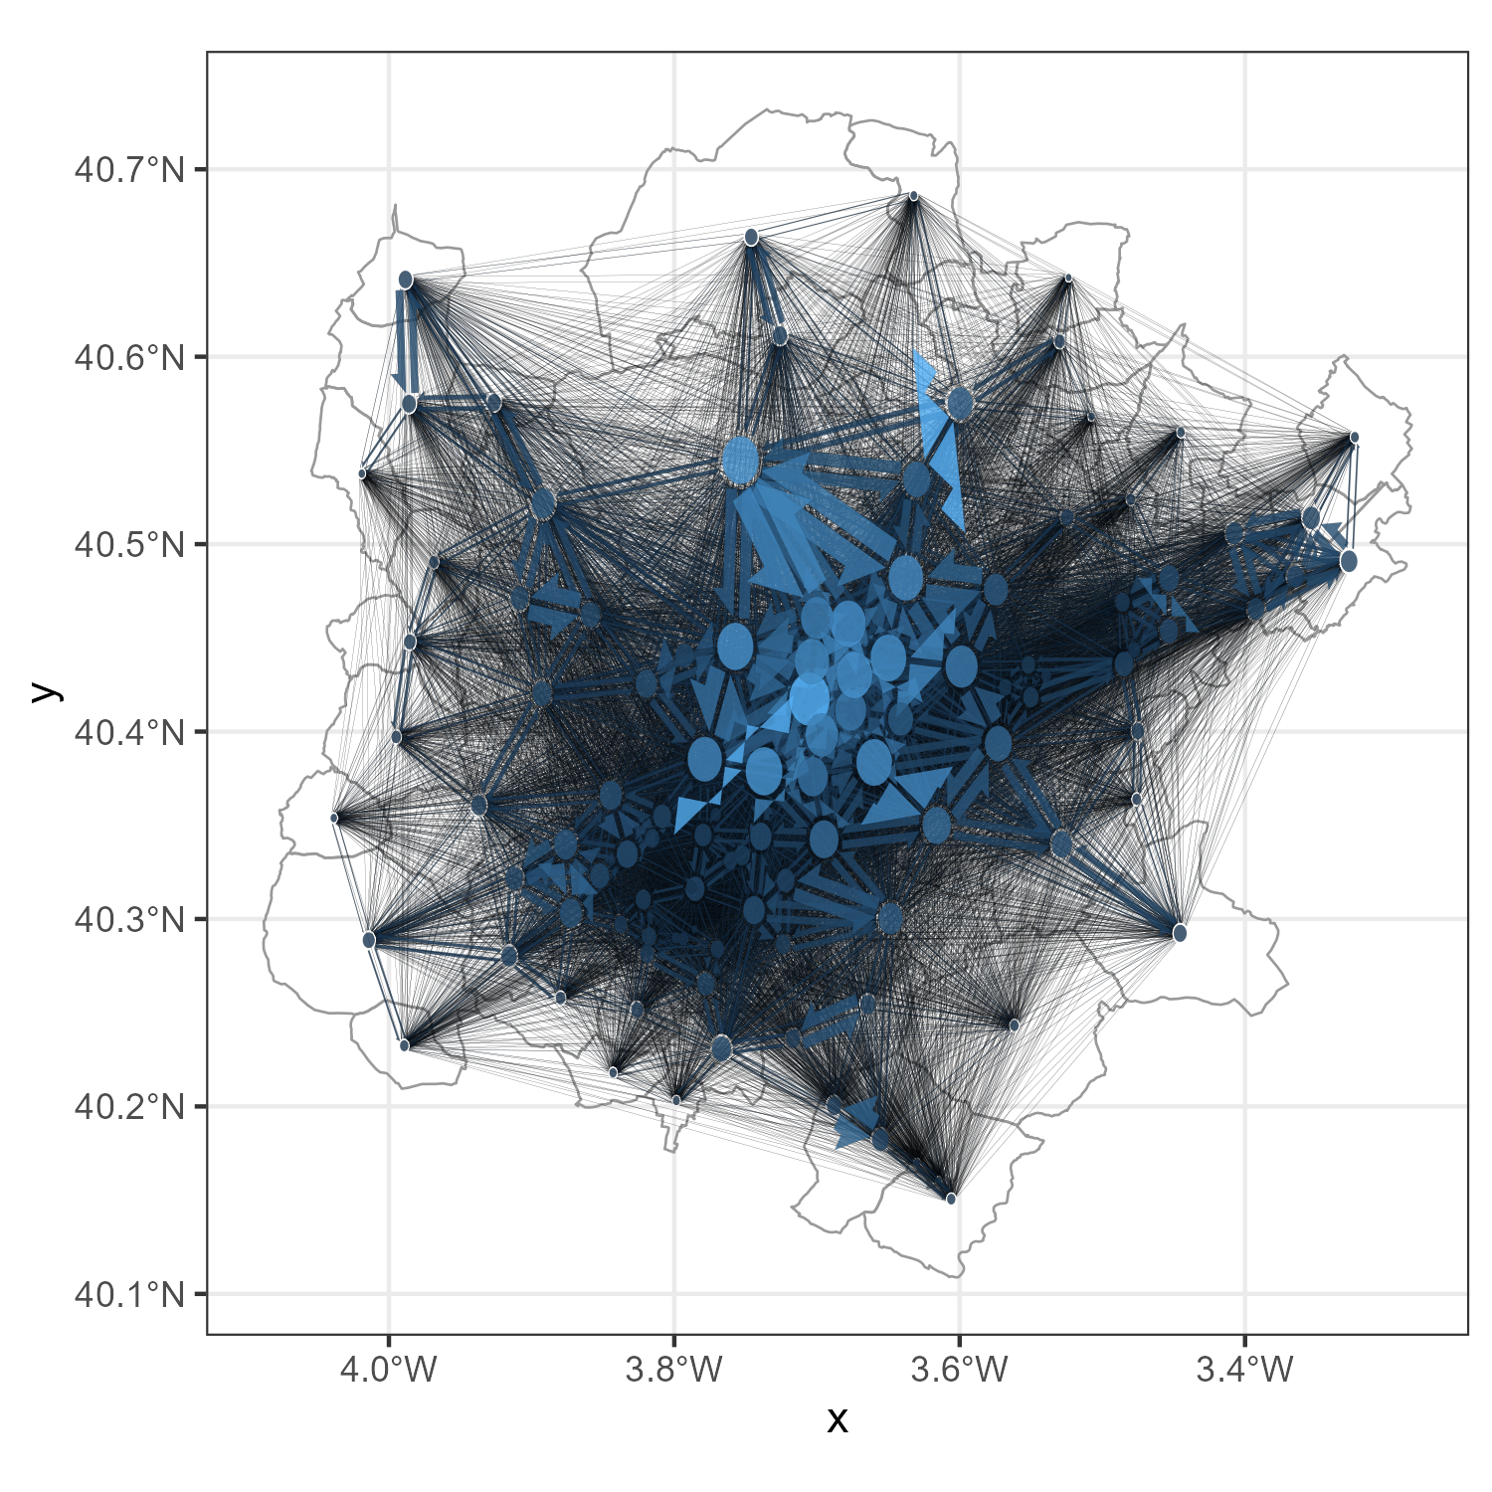
flowmapper – ggplot2 framework

Slide 6
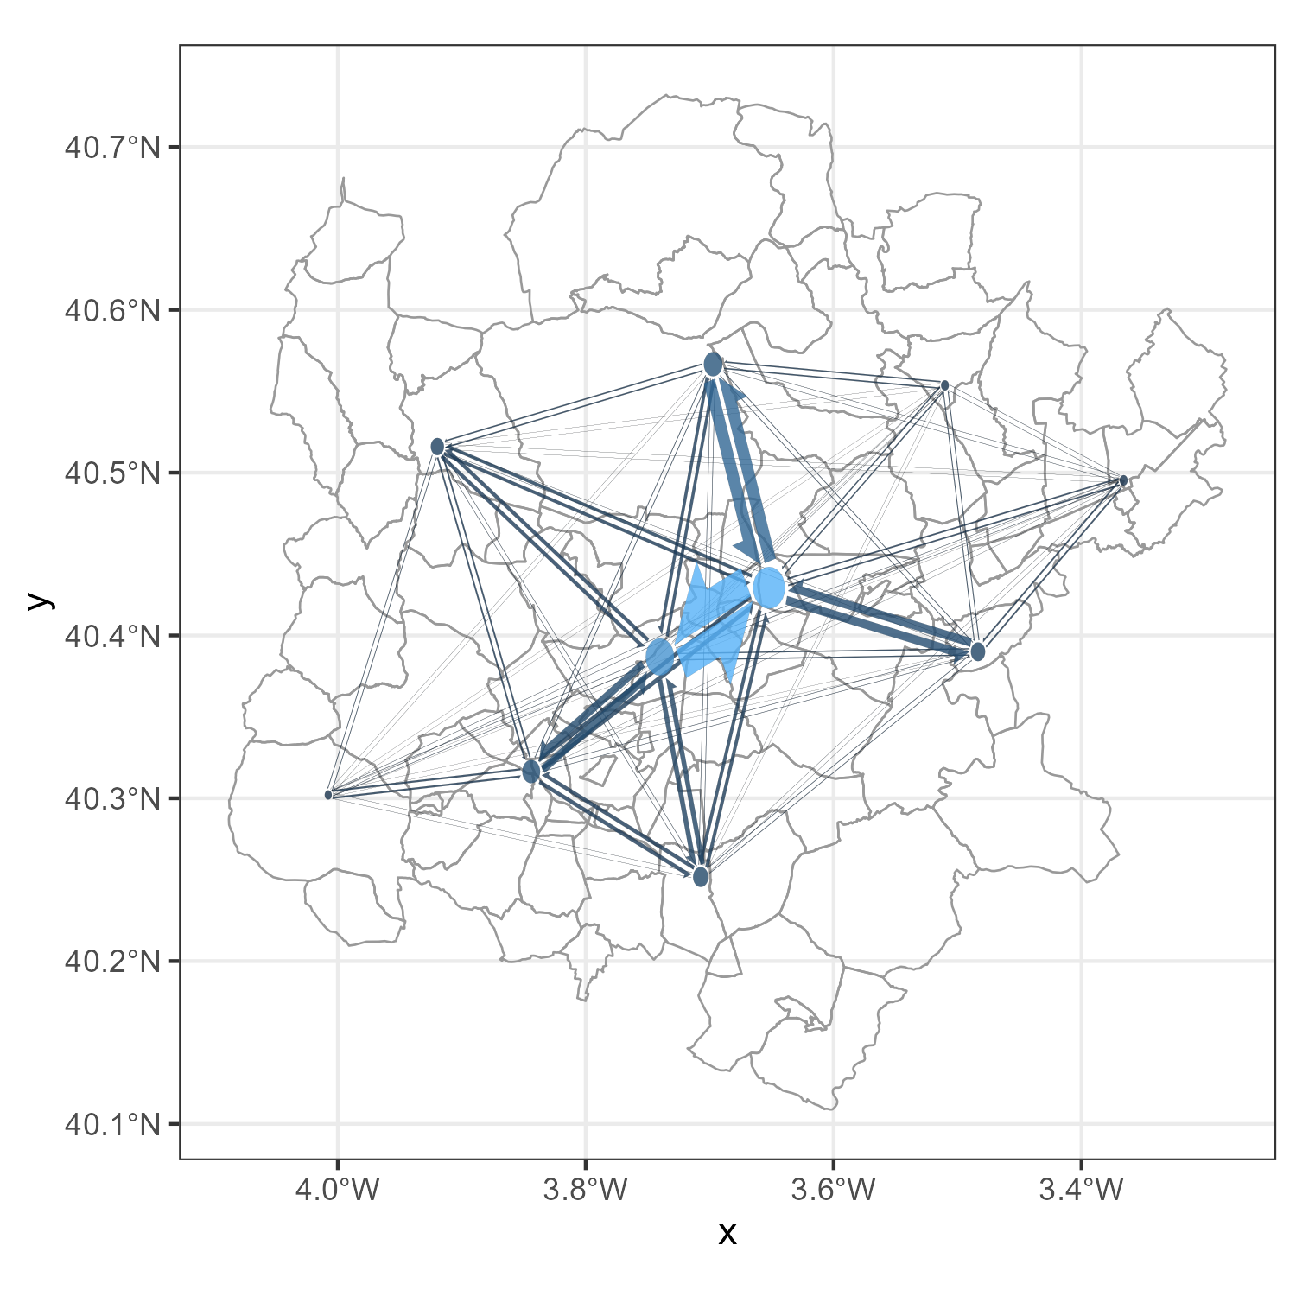
flowmapper - Clustering

Slide 7
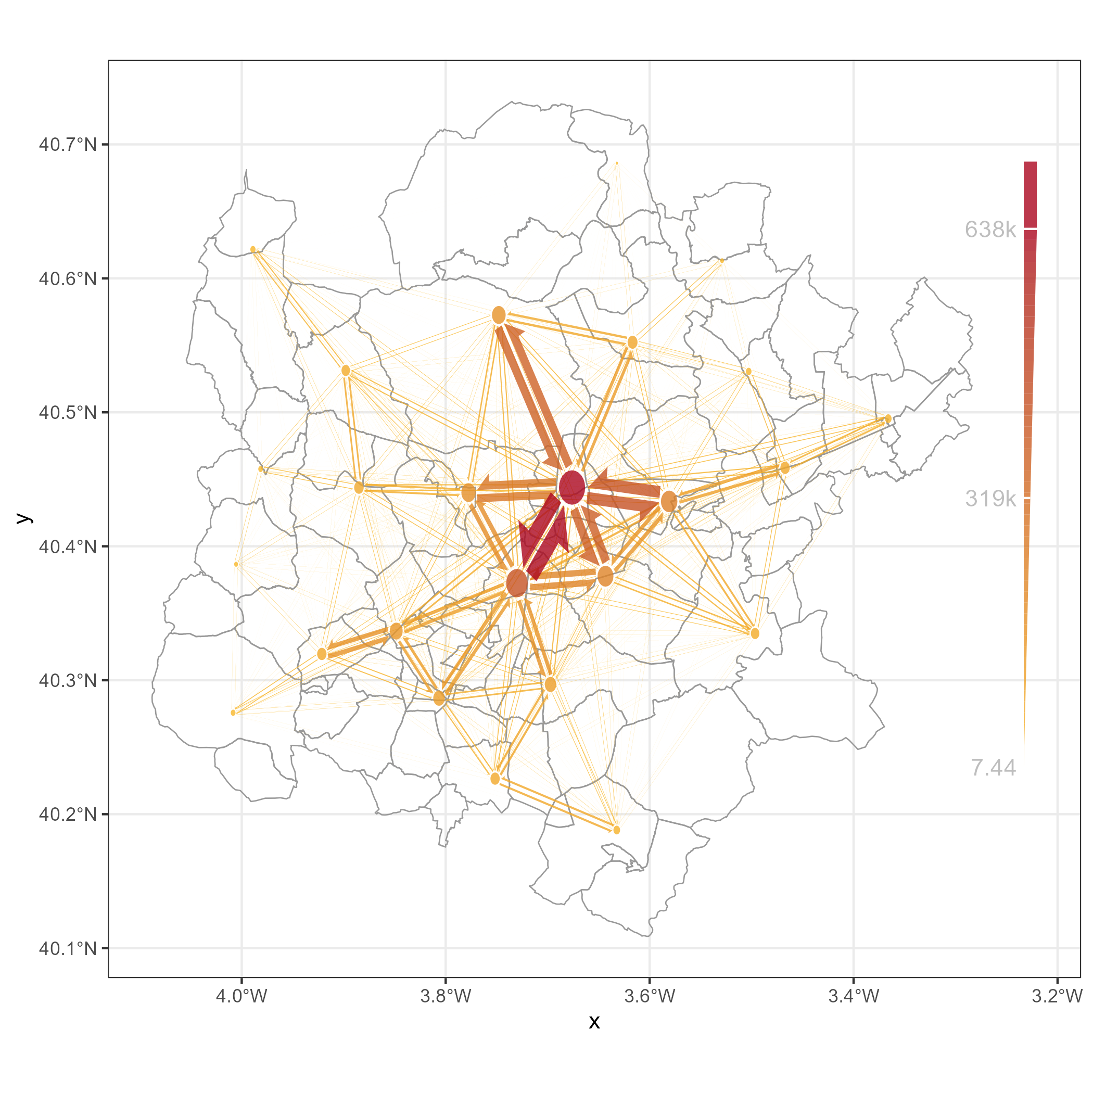
flowmapper - Customization

Slide 8
flowmapper - Adding Raster Basemaps

Slide 9
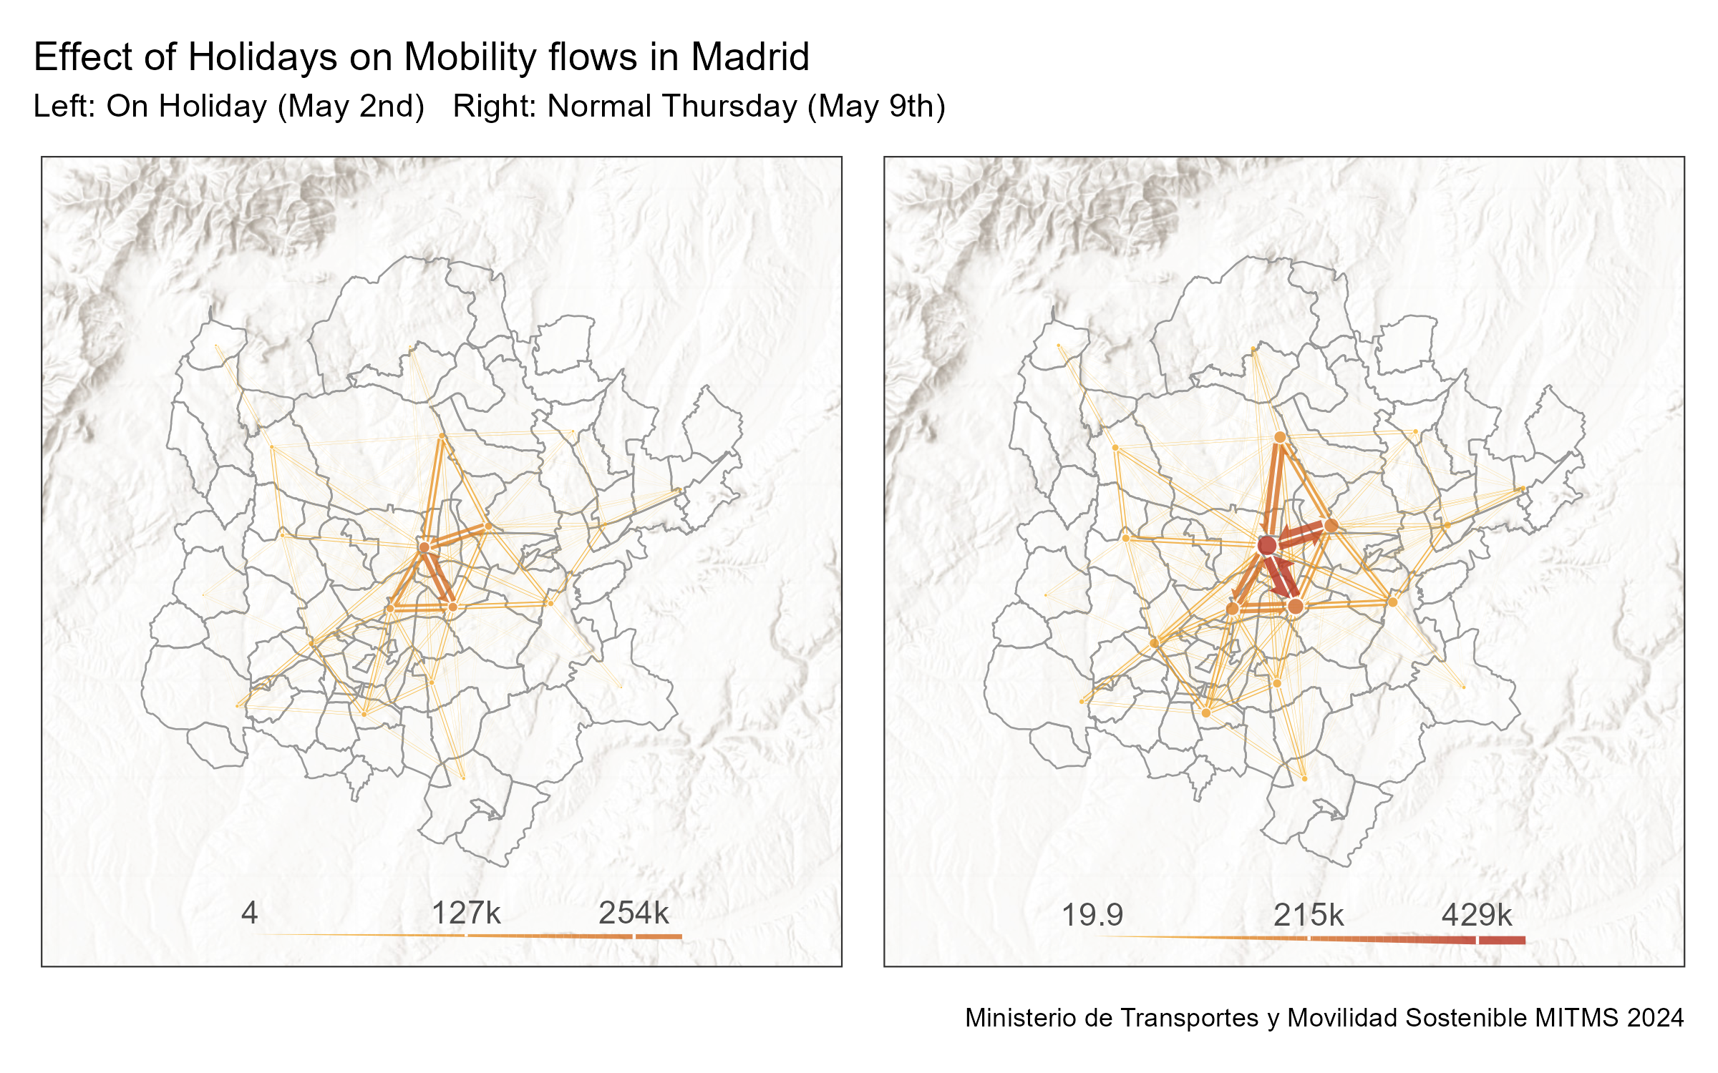
Flowmapper - Comparative Flow Maps

Slide 10
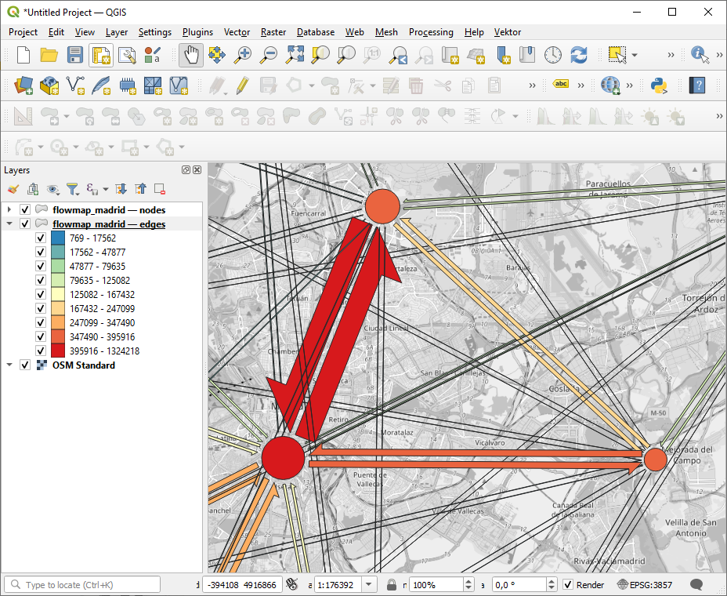



Flowmapper - Exporting as Spatial Object

Slide 11
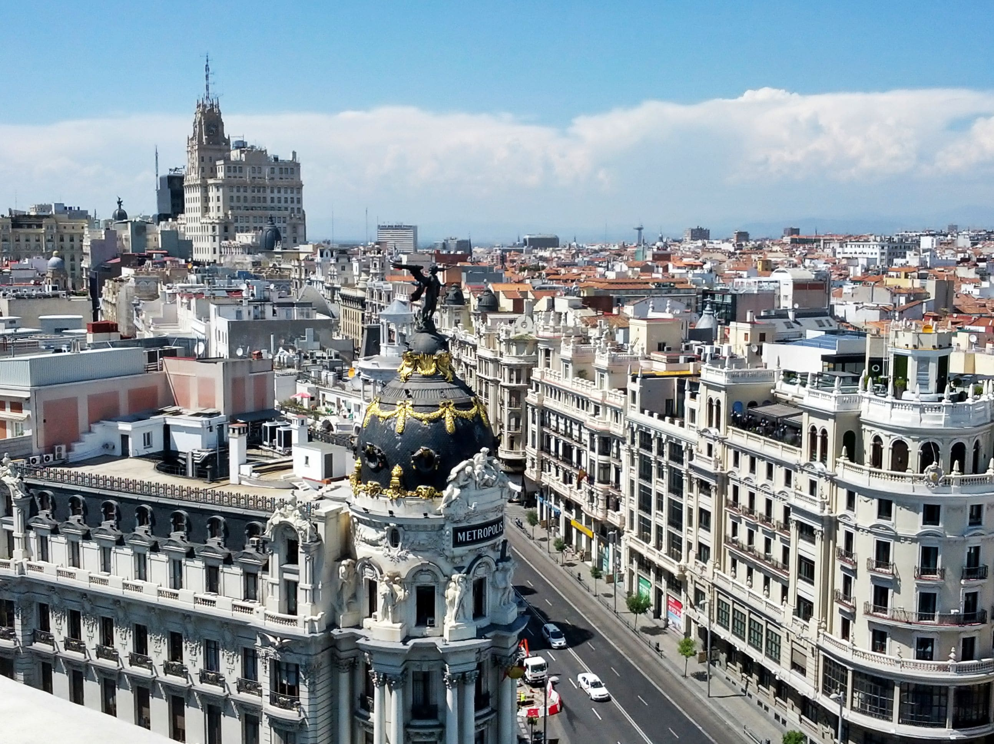
Hands-on example
Image from www.justraveling.com
Location:
Madrid, Spain
Time:
May 2nd, 2024
May 9th, 2024
Notes:
http://www.justraveling.com/free-photos-5/

Slide 12

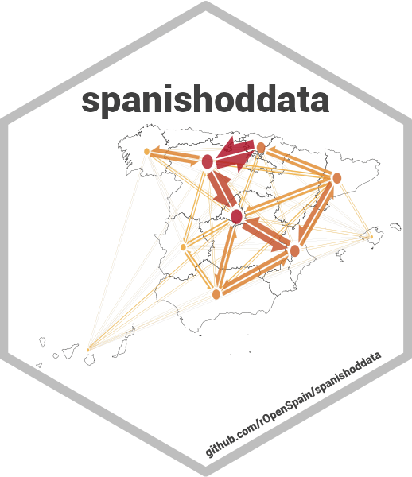
Let‘s get started!
Image from www.justraveling.com
Notes:
http://www.justraveling.com/free-photos-5/

